Slide 1
LEAD SCORING CASE STUDY
Team Members
Komal Tamboli
Chirag Tyagi
Yogesh

Slide 2
Agenda
Problem Statement
Approach
Data Analysis
Recommendation

Slide 3
Problem Statement
An education company named X Education sells online courses to industry professionals. On any given day, many professionals who are interested in the courses land on their website and browse for courses. The users fill up the form for the course.Their email address or phone number classified to be a lead. They also got lead from past referrals. Once these leads are obtained sales /marketing team making calls and writing emails.
X Education has appointed us to help them select the most promising leads, i.e. the leads that are most likely to convert into paying customers. The company requires you to build a model wherein you need to assign a lead score to each of the leads such that the customers with a higher lead score have a higher conversion chance and the customers with a lower lead score have a lower conversion chance. The CEO, in particular, has given a ballpark of the target lead conversion rate to be around 80%.

Slide 4
APPROACHES
Understand the Lead Scoring data. Used Data dictionary for data understanding.
Imported the data in the data frame and checked the metadata of the data frame.
Checked the percentage of the missing values in all columns. Accordingly dropped the columns. Dropped the unrequired columns from the data frames.
Imputed the null values with mean, median, and mode depending on suitable value.
Plotted outliers and added insights. Split the data into train and test. Made the features standardization and checked the correlation between variables. Made the model based on P-value and VIF.
Selected the features using RFE. Plotted ROC curve for train and test dataset. Checked their Accuracy, Sensitivity, Specificity, Probability, Precision, Recall.

Slide 5
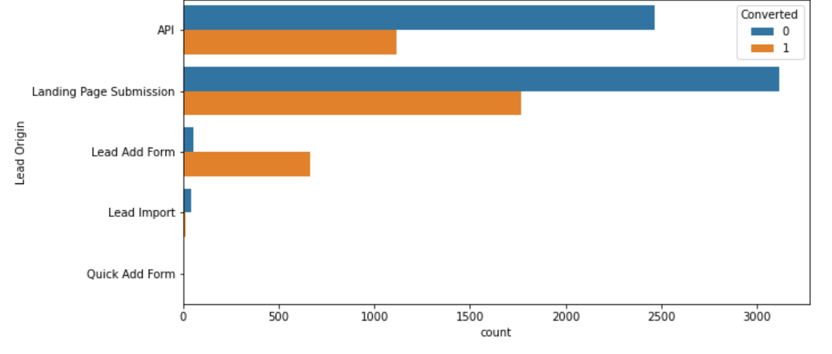
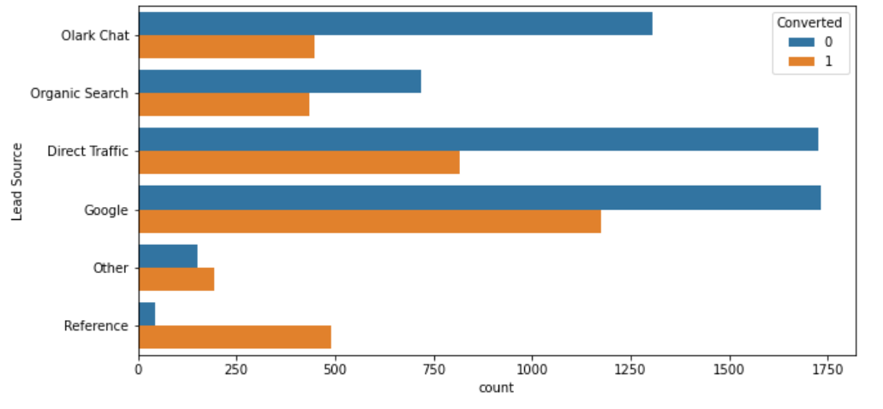
DATA ANALYSIS : CATEGORICAL 1. Maximum lead conversion happened from Landing Page submission. 2. Users used Google browser maximum time for lead conversion.

Slide 6
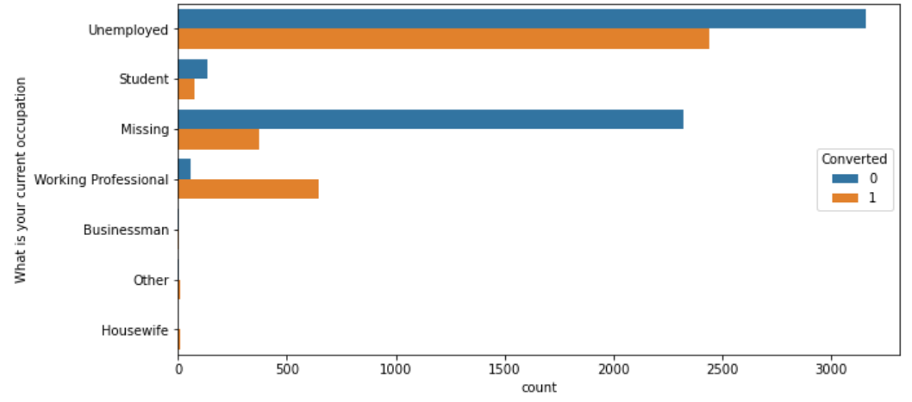
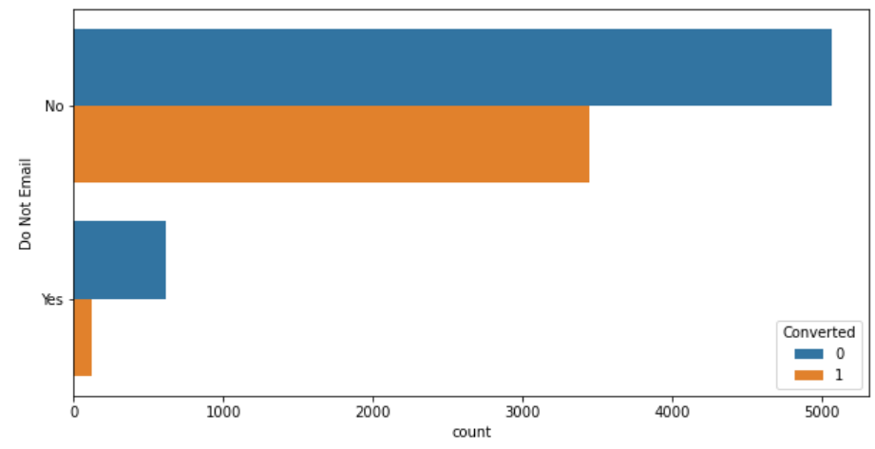
DATA ANALYSIS : CATEGORICAL 1. Major lead conversion are from the unemployment group. 2. Major lead conversion happened from Do Not Email.

Slide 7
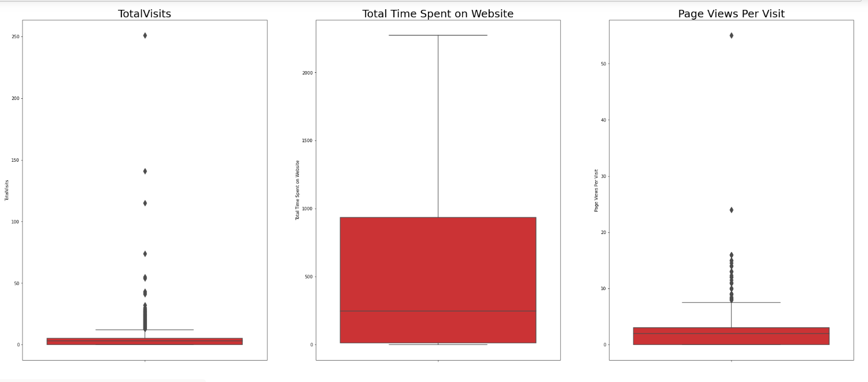
DATA ANALYSIS : NUMERICAL There are few outliers present in Total visits and Page views per visit. Used these variables in model.

